Slide 1
Senate and parliamentary procedure overview
How to make the most out of your service as a Senator

Slide 2
I’m a Senator. What’s the bare minimum I have to do?
You are agreeing to (inter alia):
Attend Senate meetings
Carefully read documents, resolutions, minutes, et cetera before meetings.
Ask good questions of speakers.
Help make proposed policies better.
Exercise decorum in debate

Slide 3
I’m a Senator. I want to be a good one.
Wherever possible, try to take the perspective of the University as a whole.
Recognize that things are very different in other parts of the University.
Wherever possible, be flexible and open to having your mind changed.
Be nice to kittens

Slide 4
Types of motions

Slide 5
Motions
Subsidiary motions
Secondary motions
Do-over motions
Privileged motions
Incidental motions
Main motions

Slide 6
What is a Senate?

Slide 7
What is a Senate?
Senators comprise senates.
Senators make motions
Senators listen to reports
Senators debate
Senators vote

Slide 8
What is a Senate?
What do Senates do?

Slide 9
What is a Senate?
What do Senates do?
They express their will via statements

Slide 10
What is a Senate?
Technical aside:
Senates supervene on their members.
But the will of a Senate does not supervene on the wills of its senators

Slide 11
Weird. So, how does a Senate will stuff?

Slide 12
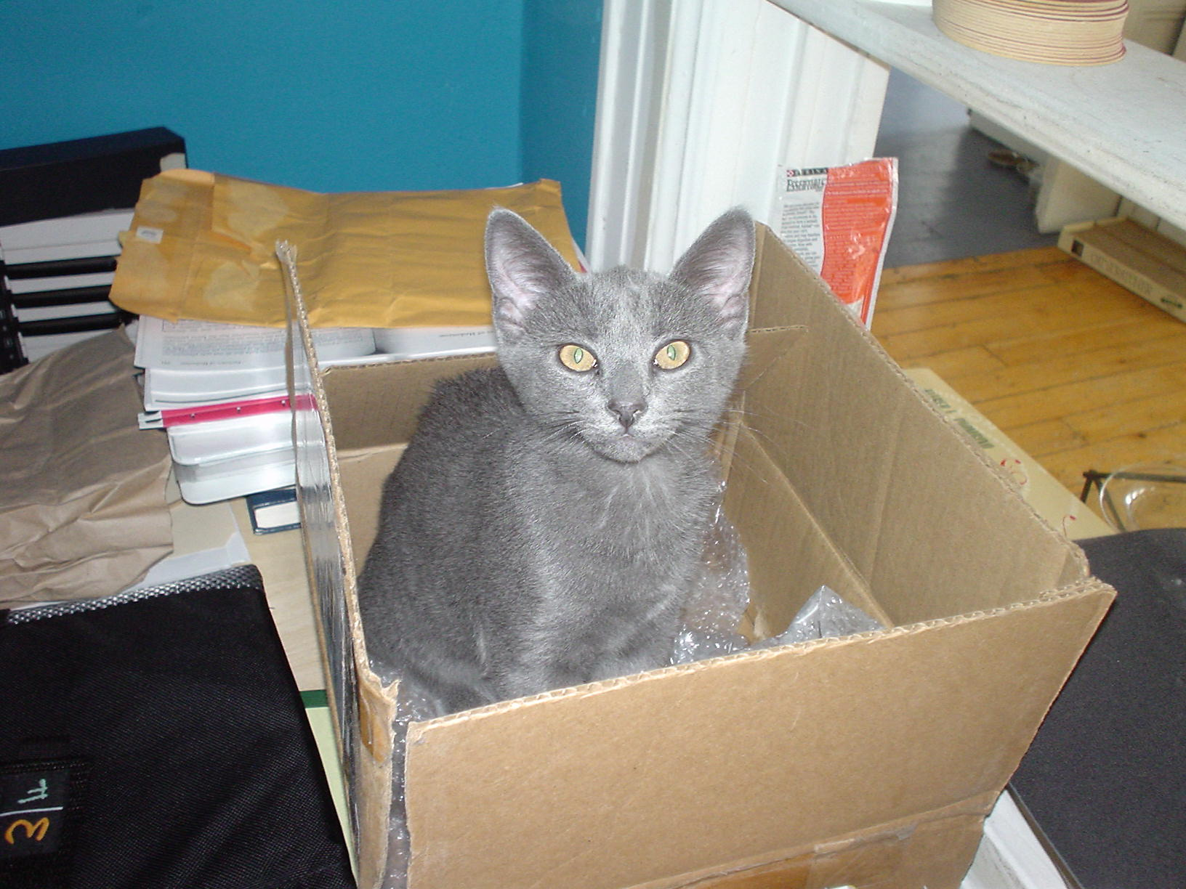
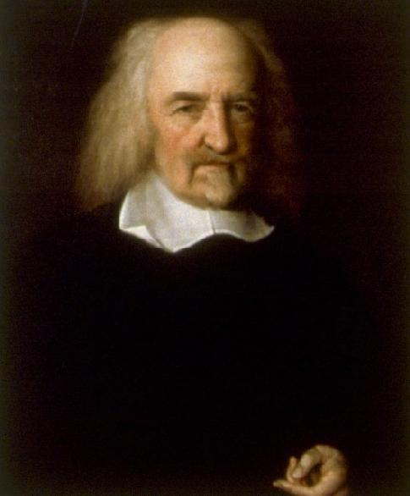
Hobbes

Slide 13
Weird. So, how does a Senate will stuff?
Motions
Back to that in a moment.

Slide 14
Weird. So, how does a Senate will stuff?
That’s not the right question.
Better: How does a Senate ensure that its actions are consonant with its members’ divergent interests?

Slide 15
Parliamentary Procedure

Slide 16
Parliamentary procedure
Two goals:
(a) Ensure that the Senate can act.
(b) Ensure that all Senators can contribute equally to the Senate’s actions

Slide 17
Parliamentary procedure
Ensure that the Senate can act.
Divide up issues into manageable chunks
Ultimately, majority rules.

Slide 18
Parliamentary procedure
(b) Ensure that all Senators can contribute equally to the Senate’s actions
Ensure that those in the minority can:
Express their opinions and attempt to convince others.
Participate in improving resolutions which they oppose.

Slide 19
Basic principles
1 person, 1 vote
Only 1 question can be considered at a time.
Once a motion is before the assembly, the question must be disposed of before doing anything else.
Only discussion germane to the pending motion is permitted.
No discussion without a motion
Move before you speak; do not speak before you move.

Slide 20
In the absence of dissent
The rules are there to help us do things and make decisions.
Where there is no dissent, the rules are not protecting anyone. Thus they may be applied loosely.
As soon as dissent is recognized, the rules are back in force.
Caveat: It is important to practice using the rules when things are calm. That helps members feel more comfortable (and trust that fairness will be ensured) when things are tense.

Slide 21
Basic steps in approving motions

Slide 22
Step 1: Making motions
Someone makes a motion
‘I move that tacos be provided at Senate meetings’
Someone seconds the motion
‘Second!’
The Chair states the motion
‘It is moved and seconded that tacos be provided at Senate meetings’

Slide 23
Step 2: Consideration
The Senate debates the motion
Subsidiary motions are introduced and disposed of by the same process

Slide 24
Step 3: Decision
The Chair puts the question
(i.e., we vote on the motion )
The Chair announces the result

Slide 25
Making motions
Step 1

Slide 26
Resolution
Resolutions are main motions
(or, they are the content of main motions)

Slide 27
Committee-introduced motions
Most Senate business involves resolutions that have been created by a committee.
The committee representative(s) introduces the resolution.
No second is required
At this point, the motion belongs to the body.
Committee representative(s) are assigned the floor first.

Slide 28
Consideration
Step 2: The fun stuff

Slide 29
Asking for information

Slide 30
I have a question about the resolution
Normally:
Raise your hand.
Wait for the Chair to notice and add you to the speakers’ list.
Listen attentively to your colleagues.
Wait for the Chair to call on you….

Slide 31
I have a question about the resolution
If it’s a quick question or waiting will be harmful to the debate:
Wait until the person speaking finishes.
Before the Chair calls on someone else, stand and follow the instructions as though you’ve been assigned the floor.
Interruptions of speakers are permitted, but generally unnecessary and unhelpful

Slide 32
….still waiting
Hold on! Am I giving up my turn to speak for/against the motion?
No. Well, probably not.
Ummm, perhaps some more explanation?
This is a Privileged Motion. You are not speaking in debate.
The catch is that these motions can be abused to conduct debate out of order. The remedy is the Chair treating abusive motions as debate.

Slide 33
The floor is yours!
Stand
State your name and say either:
I have a request for information; or
I would like to raise a point of information
Say what you would like to know
Sit down
The Chair will direct the question as appropriate
Usually these go to the committee representative(s)

Slide 34
I oppose this resolution. What do I do?
Is this resolution so extraordinarily bad that giving it the dignity of a vote would embarrass the Senate?
Yes
Really? Are you sure?
Yes. I’m sure. We should not seriously debate the motion: “the Senate endorses replacing impaction with the murder of randomly selected students”
You should….

Slide 35
Objection to the Consideration of the Question
What it does
Prevents any debate or consideration of the motion.
Special Considerations
Must be moved before any debate or subsidiary motion (except Lay on the Table)
Vote | Second | Debatable | Amendable | Interrupt
Two-thirds | No | No | No | Yes

Slide 36
I oppose this resolution. What do I do?
It’s not that bad. So what should I do?
Two options (you may do both, but not at the same time)
Option 1: Speak against the motion
Option 2: Propose an amendment

Slide 37
I want to speak against the motion
Raise your hand.
Wait for the Chair to notice and add you to the speakers’ list.
Listen attentively to your colleagues.
Wait for the Chair to call on you….

Slide 38
The floor is yours!
Stand
State your name and that you oppose the motion
Make the best argument you can for why your colleagues should vote against the motion.
You’re only going to get one chance, so make it count.
Get the point fast; Stay on topic.
Do not refer to other Senators by name.
Sit down

Slide 39
Amendments
Oy vey. This is complicated.

Slide 40
I want to propose an amendment
Wait. I thought you can’t vote against a motion that you amended.
No. That is false.
It generally looks bad to vote against an amendment you proposed. But there’s no requirement.
It is a fundamental feature of the process that opponents be able to try to make a proposal as good as possible before voting against it.

Slide 41
I want to propose an amendment
Raise your hand.
Wait for the Chair to notice and add you to the speakers’ list.
Listen attentively to your colleagues.
Carefully formulate your amendment
Write it out if it is long or involved
Wait for the Chair to call on you….

Slide 42
The floor is yours!
Stand
State your name and that you seek to propose an amendment
State your amendment as clearly and carefully as possible.
Be patient as the proposal is recorded. Typing in front of a hundred people sucks.
Wait for the amendment to be seconded
Someone may shout ‘Second!’ or the Chair may ask if there is a second.

Slide 43
The floor is yours!
If the amendment is seconded, the Chair will state the amendment.
After stating the amendment, the Chair will ask if you would like to speak in favor of your amendment.
Make the best argument you can for why your amendment improves the motion.
Sit down
The debate is now on your amendment.
Subsidiary motions are now in order.
Comments that are about the main motion are out of order

Slide 44
Stating amendments
Are there special and highly technical rules governing how an amendment is stated which can have profound effects on the debate?
Yes. But the Chair will not allow the debate to be undermined by technicalities.

Slide 45
Someone else offered an amendment which I don’t like. What do I do?
Option 1: Speak against the amendment
See above

Slide 46
Speaking against an amendment
Will I lose my turn to speak against the main motion if I speak against an amendment?
No. Amendments are motions. You may speak once per motion.
Can I speak against an amendment and offer an amendment to it?
Yes. But not at the same time. Decide which you want to do first. Once you’ve done it, raise your hand again to get back in the queue.
The Chair may look at you funny. It may help to mouth ‘amendment’

Slide 47
Someone else offered an amendment which I don’t like. What do I do?
Option 1: Speak against the amendment
See above
Option 2: Offer an amendment to the amendment
See ab….Wait….What?

Slide 48
Amending Amendments?!?!
You’re kidding me, right?
No.
Can I amend an amendment to an amendment?
No. That way lies madness. Vote against the amendment and propose a new one.
Are there special rules about germaneness that kick in here?
Yes. You don’t want to know them.
In general, it is usually best to just reject an amendment and propose a better one.

Slide 49
Voting
Step 3

Slide 50
When do we vote?
Votes are taken after one of two things happen.
Everyone who wishes to speak on the motion has spoken.
A motion is passed to Call the Question

Slide 51
Previous Question
What it does
Immediately closes debate and brings the assembly to a vote on the pending question (or questions)
Special Characteristics
Only the motion to Lay on the Table is in order
Vote | Second | Debatable | Amendable | Interrupt
Two-thirds | Yes | No | No | No

Slide 52
Voting: The basics
Majority
Most motions require a majority
Two-thirds
Only required on motions which override the rights of individuals.
Namely, motions which
(a) suspend or modify a previously adopted rule of order; or
(b) prevent introducing a question for consideration; or
(c) close, limit, or extend debate; or
(d) close nominations; or
(e) take away membership

Slide 53
Voting: Majority
“Majority” means “More than half of the votes by persons entitled to vote, excluding blanks or abstentions, at a regular or properly called meeting.” [§44]
NB, this implies: A motion requiring a majority passes if and only if it is approved by a majority of those voting.
Examples:
If 19 votes are cast, a majority (more than 9.5) is 10
If 20 votes are cast, a majority (more than 10) is 11

Slide 54
Voting: Two-thirds
“A two-thirds vote… means at least two thirds of the votes cast by persons entitled to vote, excluding blanks or abstentions, at a regular or properly called meeting.” [§44]
Examples
If 30 votes are cast, a two-thirds vote is 20
If 31 votes are cast, a two-thirds vote is 21
[Pro tip: If you want to annoy a philosopher, include an unexplained asymmetry in your rules]

Slide 55
Types of votes
Voice vote
Most decisions are handled this way
If the Chair is uncertain, a hand/rising vote will be taken.
Any Senator can call for a hand/rising vote by exclaiming ‘Division!’
Secret ballot
Elections conducted during meetings
Roll call
Requires a motion approved by one-fifth of the members present

Slide 56
Who votes
All and only senators may vote (Bylaws III.8.2)
Chair voting
The Chair is a member of the Senate. The Chair may vote on any issue.
However, a Chair should only vote when her vote will affect the outcome
Ties
Only one vote more in the affirmative than in the negative.
[Yay = 100; Nay = 99] => motion passes
[Chair votes against] => [Yay = 100; Nay = 100] => motion fails
Notes:
RR p.53; p.405

Slide 57
abstentions

Slide 58
Abstentions
Can you abstain from a vote?
Absolutely!
How do you do it?
A two step process:
When the Chair asks for those in favor to say ‘Aye!/Yay!’, close your mouth and do not open it.
When the Chair asks for those opposed to say ‘Nay!’, close your mouth and do not open it.
Why not count them?
Abstentions are not votes. They are privations of votes.

Slide 59
Common misconceptions

Slide 60
Lay on the Table

Slide 61
Lay on the Table
What it does
Suspends action on the present question so can attend to more pressing business.
Special considerations
Not in order if no pressing business.
Blocks consideration of related issues (rare)
Vote | Second | Debatable | Amendable | Interrupt
Majority | Yes | No | No | No

Slide 62
Lay on the Table
Misuse:
Attempting to kill a question without directly voting on it.
Why:
Dangerous.
The question can be taken from the table at any time with a majority
See, Parks and Recreation Season 6 Episode 6
Instead:
Objection to Consideration of The Question
If debate is just beginning and the motion is embarrassing
Postpone Indefinitely

Slide 63
Lay on the Table
Misuse:
Moving to table until a definite time
Why
The new time should be debatable. But this motion cannot be modified or qualified.
Instead:
Motion to Postpone Definitely

Slide 64
Motion to Substitute
That is not the motion you are looking for….

Slide 65
Substitute
Misuse:
Moving to strike text from the motion and replace it with new text.
Why
Usually complicates the process unnecessarily.
The motion to substitute requires three steps:
(1) Perfect the substitute text.
(2) Perfect the original text.
(3) Vote on whether to adopt the original or the substitute.
Instead
Move to amend by striking out x and inserting y

Slide 66
Friendly amendments
AAAAAAAAAAARRRRRRGGGGGG!!!

Slide 67
Bad! Wrong! No!
Senator Red: I move that tacos be served at every Senate meeting.
Senator Blue: Second!
Chair: It is moved and seconded that tacos be served at every Senate meeting.
Senator Green: I’d like to make a friendly amendment that we add ‘and burritos’ between the words ‘tacos’ and ‘be.’
Senator Red: I take that to be friendly.
Chair: Very well. The question is on the motion that tacos and burritos be served at every Senate meeting.

Slide 68
Problem 1: Undermines the second
Senator Red: I move that tacos be served at every Senate meeting.
Senator Blue (notorious burrito hater): Second!
Chair: It is moved and seconded that tacos be served at every Senate meeting.
Senator Green: I’d like to make a friendly amendment that we add ‘and burritos’ between the words ‘tacos’ and ‘be.’
Senator Red: I take that to be friendly.
Chair: Very well. The question is on the motion that tacos and burritos be served at every Senate meeting.
Motions require seconds to ensure that Senate business is not wasted on items which only one person supports.
In the minutes, Senator Blue would be identified as the second of something she opposes.

Slide 69
Problem 2: The motion belongs to the body
Senator Red: I move that tacos be served at every Senate meeting.
Senator Blue: Second!
Chair: It is moved and seconded that tacos be served at every Senate meeting.
Magic has happened!
The motion now belongs to the Senate.
Senator Red has no special authority over it.

Slide 70
Friendly amendments
Acceptable use #1:
Annoying pedants who have a basic knowledge of Robert’s Rules
Acceptable use #2:
Shorthand for “I like this motion so much. I want to be friends with it. That said, I feel like my new friend would be even better if it were amended as follows….”

Slide 71
Ninja-level
Suppose a ‘friendly amendment’ has two properties:
(a) Alters the content of the main motion.
(b) Requires only the motion’s maker’s approval to take effect.
Can this ever happen?

Slide 72
Yes!
Case 1:
The motion has not yet been seconded.
Case 2:
The motion has been made and seconded.
The Chair has not yet stated the motion.
The Senator who seconded suggests the amendment.
C.f., RONR §33.c

Slide 73
Disputes and appeals

Slide 74
I think the Chair made a mistake about parliamentary procedure.

Slide 75
I think the Chair made a mistake about parliamentary procedure.
Not possible.

Slide 76
I think the Chair made a mistake about parliamentary procedure.
Don’t
Google madly
Do
Raise a Point of Order; or
Appeal the ruling of the Chair
Notes:
Sec 24

